Slide 1
Welcome!
Hari Polnati

Slide 2
Course Agenda
Java SE (Core Java):
Basics of Java - Essentials
Object oriented programming
Collection Framework and Generics
Exception Handling
Functional programming, Java8 and Java 11 Features
Concurrency
Spring Boot:
Understanding on Web, N-tier and Enterprise applications
Spring Modules
Spring vs Spring boot
Dependency Injection
Spring boot project with Spring initializer
Hello world API with Spring boot ☺
Spring Boot Magic – Starters, Auto Configuration, Embedded servers
Spring boot Actuator, devtools
Understanding REST API – Richardson Maturity Model
Spring Data JPA and CRUD operations with either mysql (or) mongodb/cosmosdb
Consumes REST API’s from spring boot app.
AOP – Aspect oriented programming
Optional : Dockerizing spring boot app

Slide 3
Basics of Java - Essentials

Slide 4
Prerequisites
Basics of any programming language

Slide 5
Java Initiated by
Games Gosling
Patrick Naughton
Chris Warth
Ed Frank
Mike Sheridan
Official doc for java: https://www.oracle.com/in/java/

Slide 6
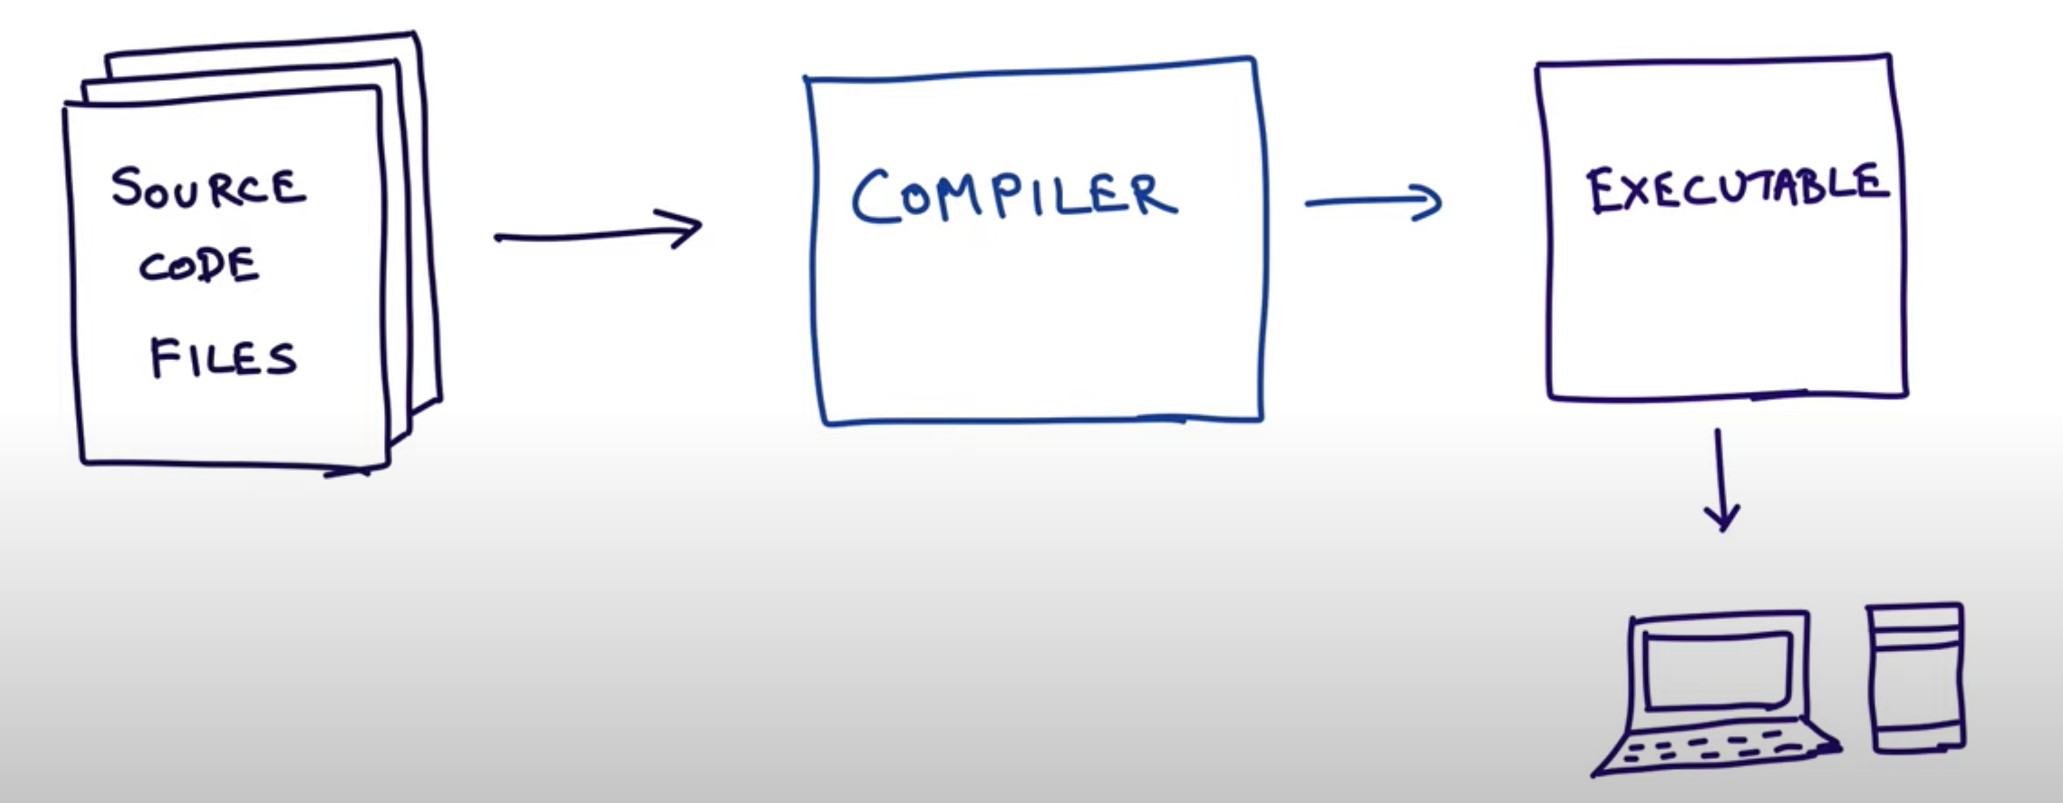
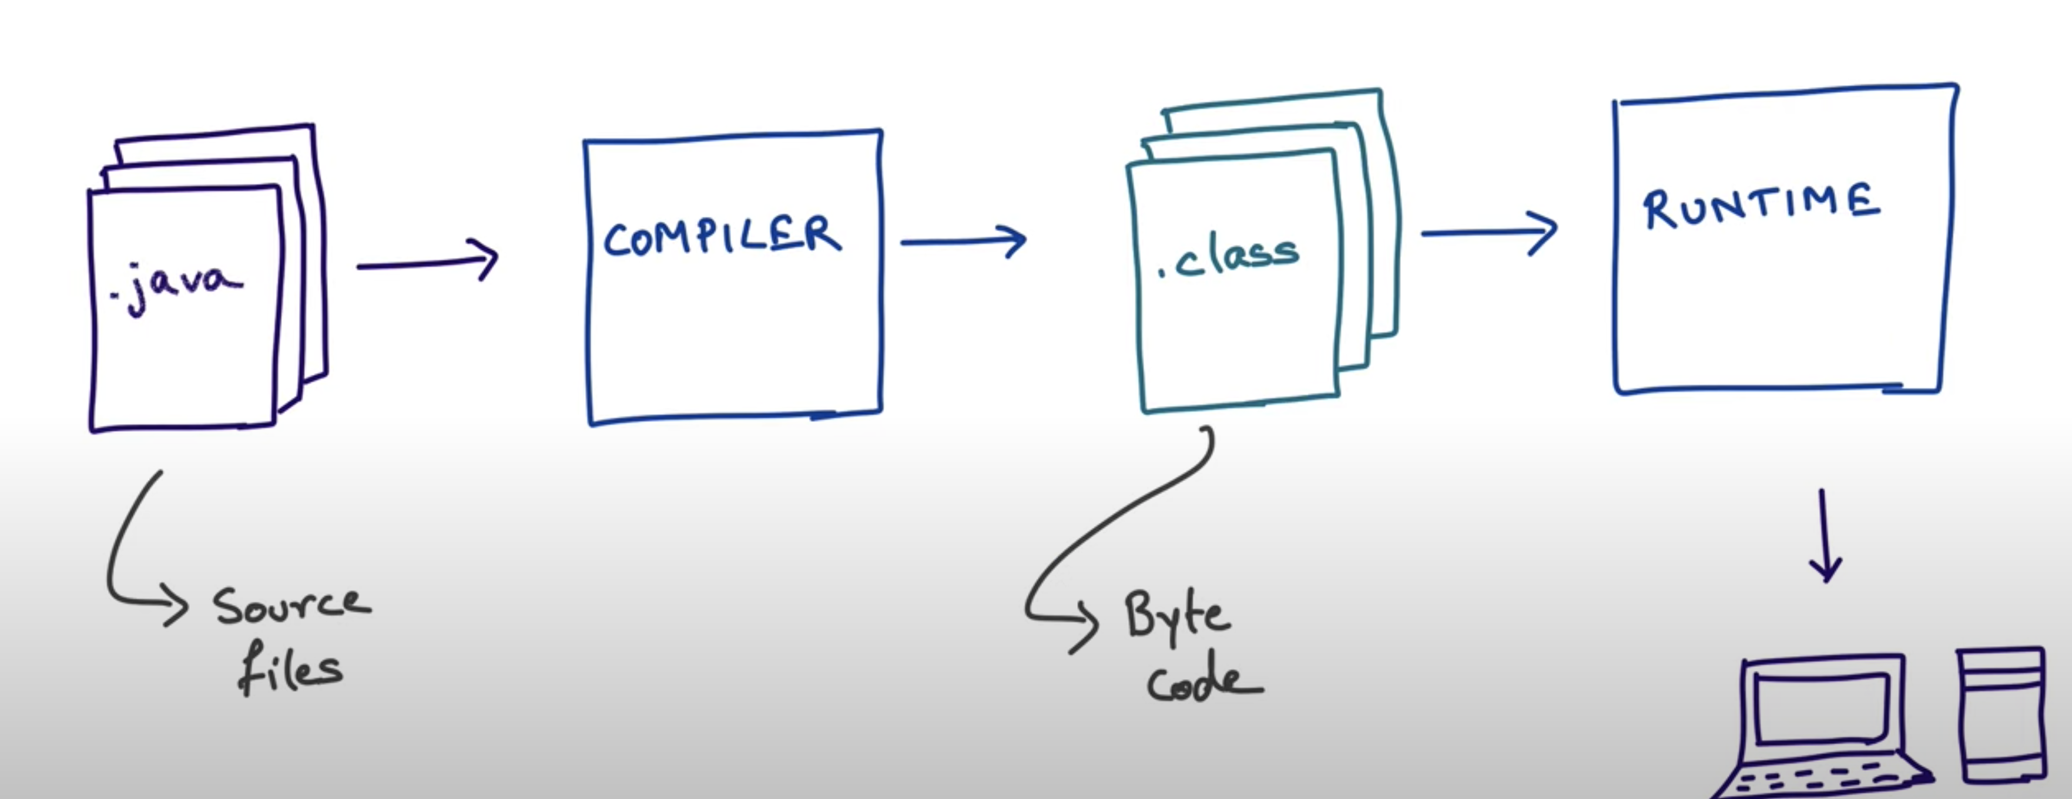
Primary goal of Java
Platform independence – Write once run anywhere (WORA)
C/C++ Model
Java Model
JVM
Advantages:
Write once run any where
Security – JVM acts as sandbox

Slide 7
Five design goals
It must be simple, object-oriented, and familiar.
It must be robust and secure.
It must be architecture-neutral and portable.
It must execute with high performance.
It must be interpreted, threaded, and dynamic.
Source: https://en.wikipedia.org/wiki/Java_(programming_language)

Slide 8
A bit dig into Java platform
javac
java

Slide 9
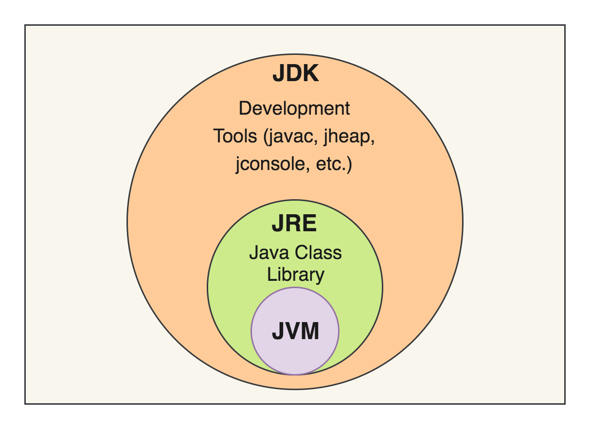
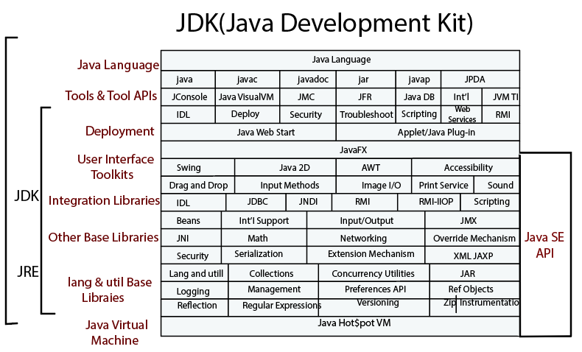
JDK vs JRE vs JVM
JVM – Java virtual machine -> runs java byte code
JRE – JVM + Libraries + Other components
JDK – JRE + Compilers + debuggers

Slide 10
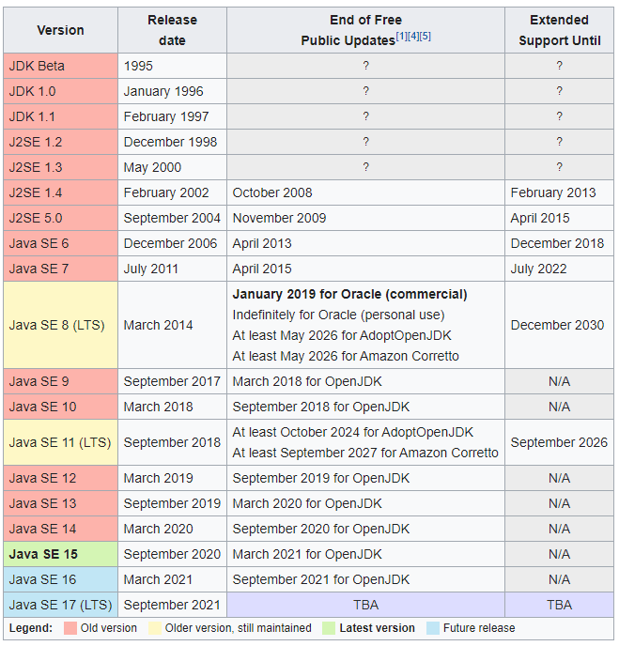
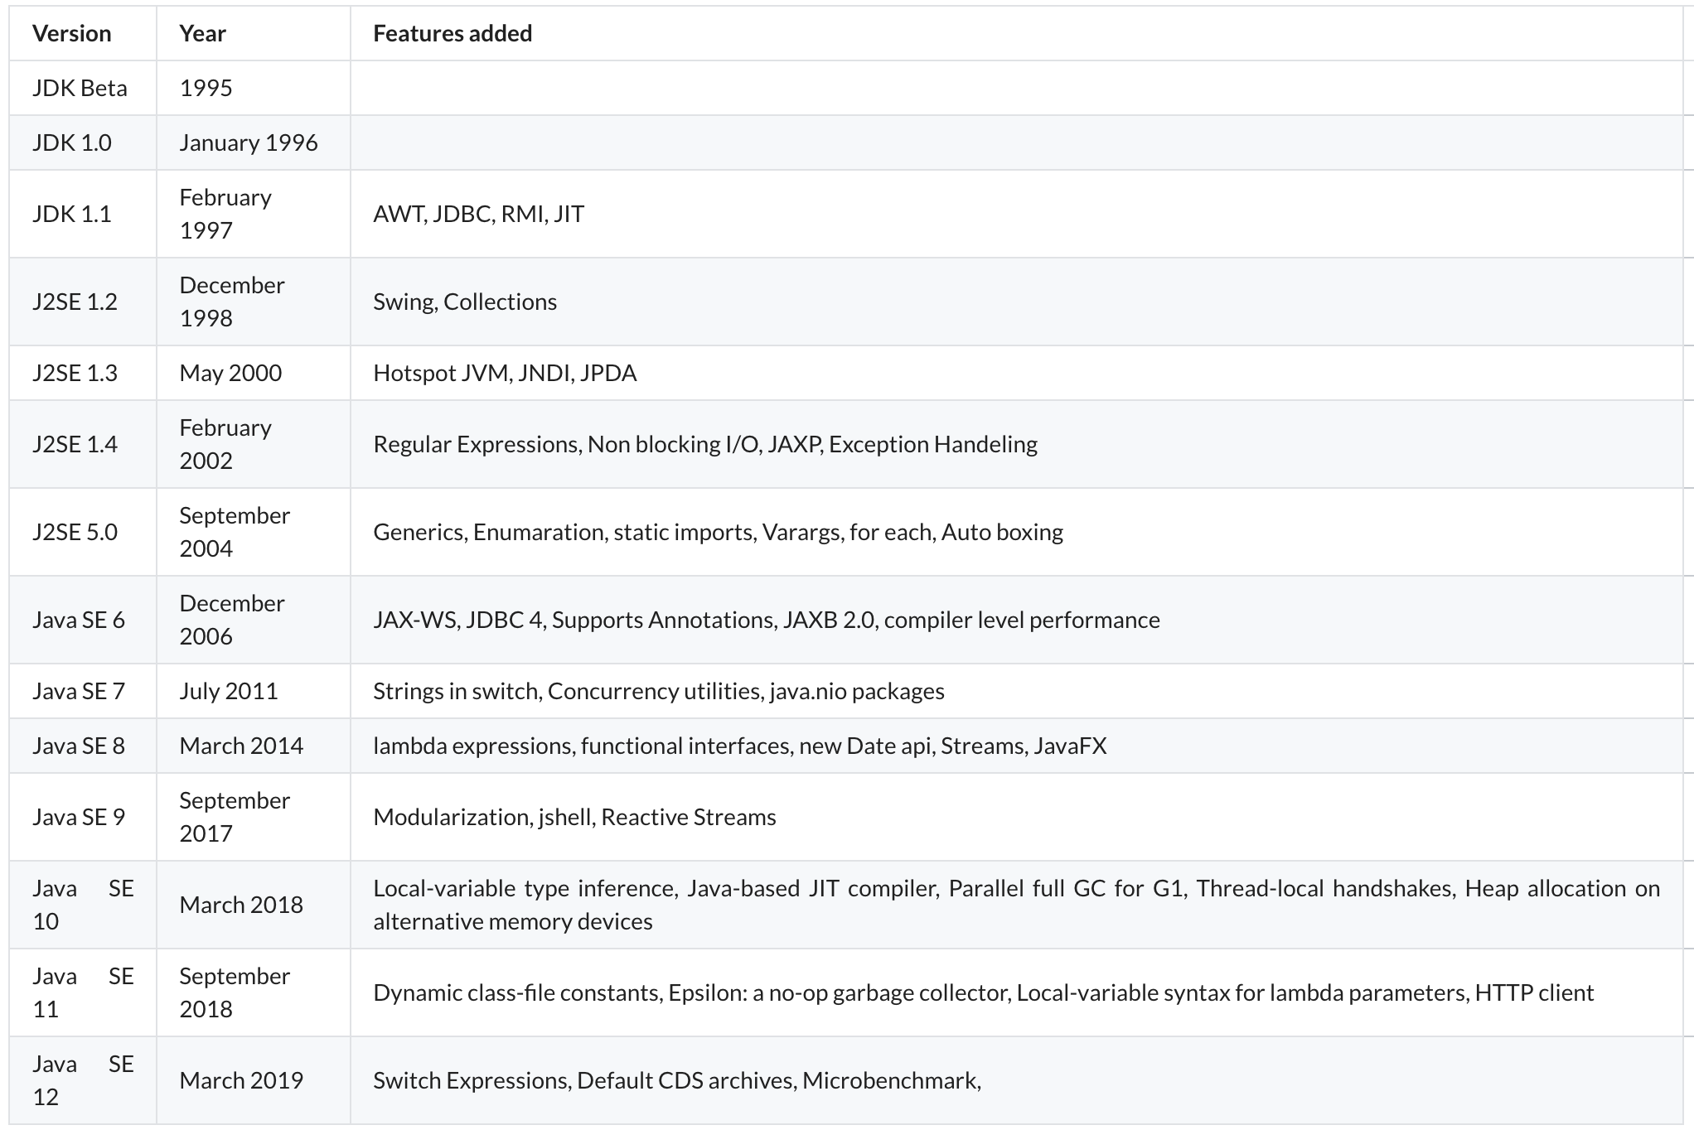
Java version History and Features

Slide 11
Required tools and s/w (optum Appstore)
Java 11 or above version (Adopt open JDK)
Eclipse/STS(Spring tool suite)/IntelliJ IDEA Community Edition
Postman
Maven
git

Slide 12
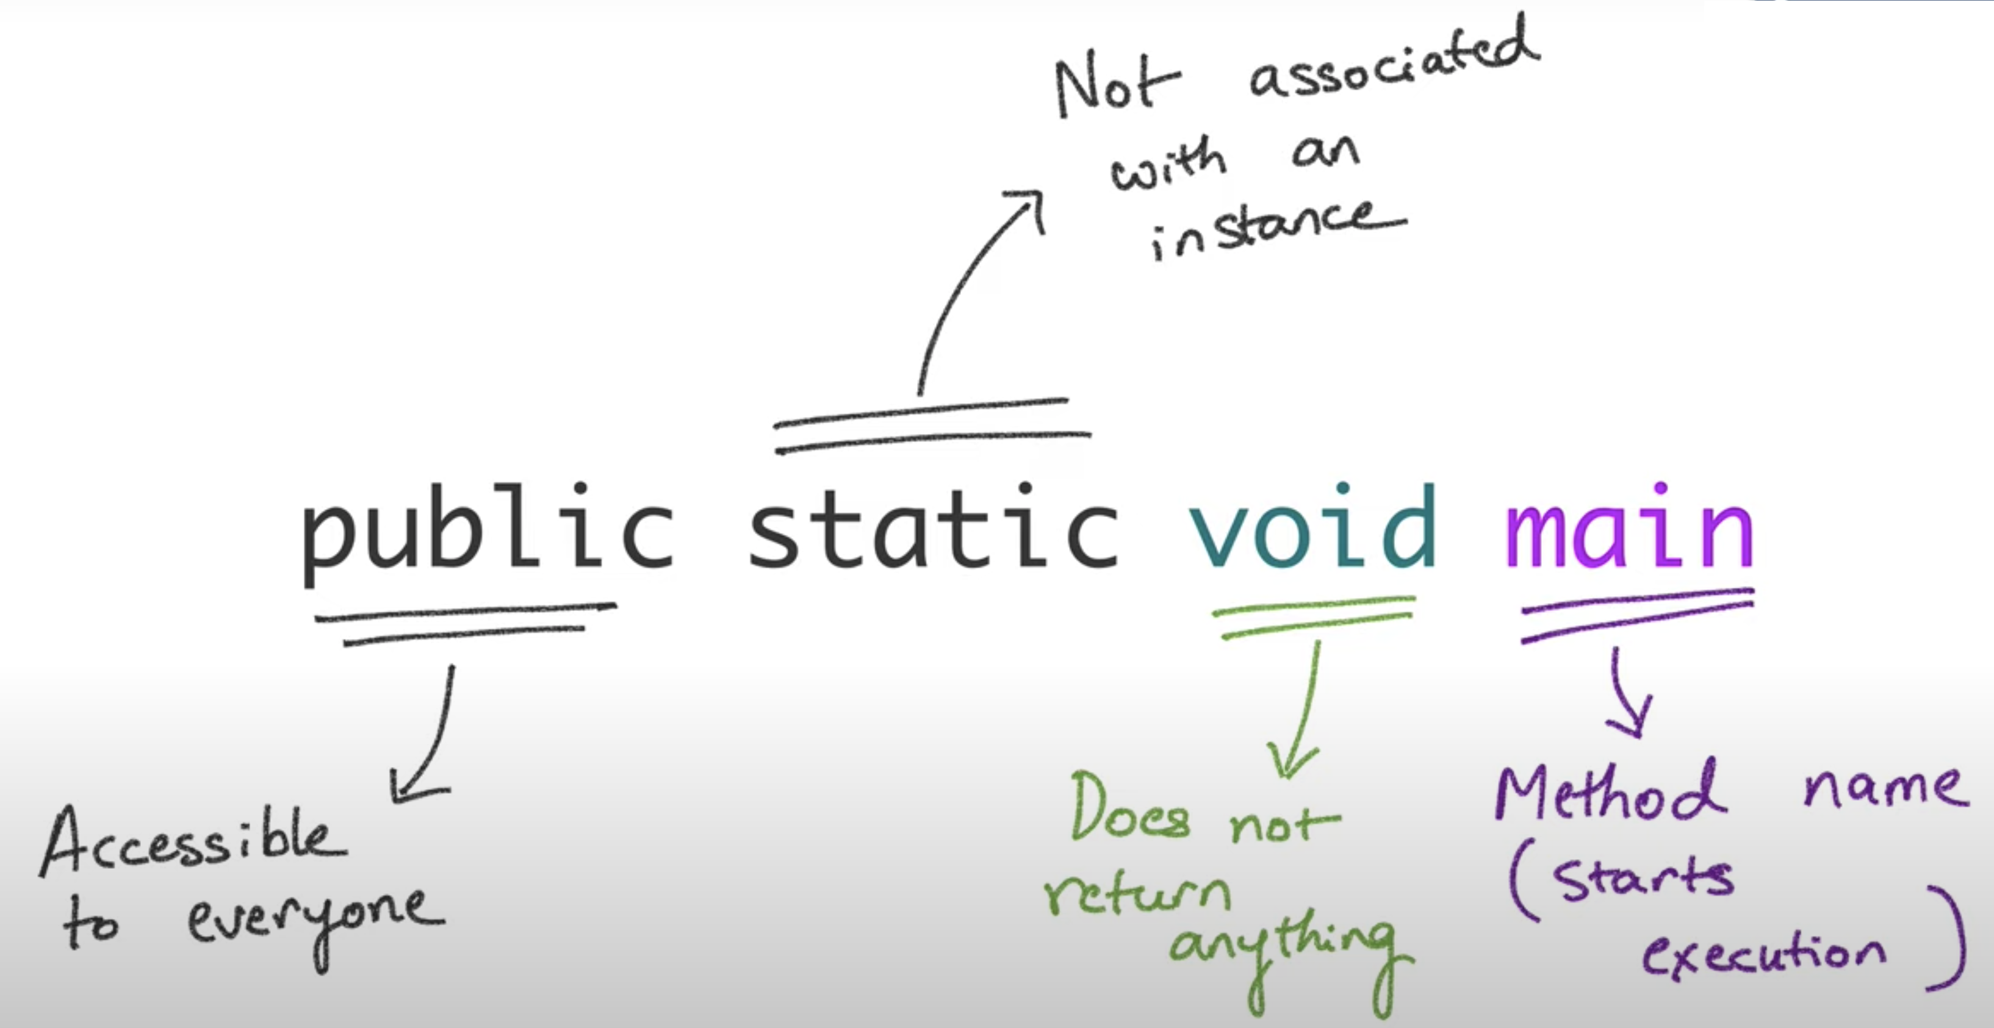
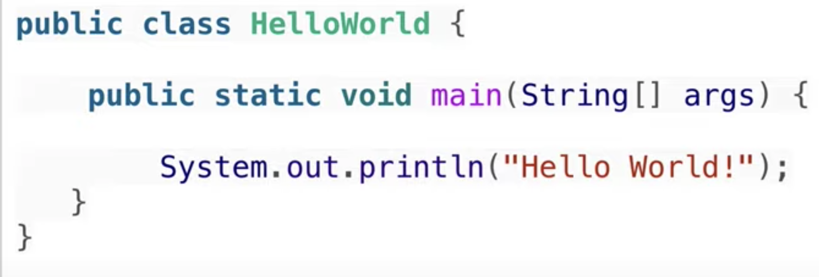
Let’s write and explore “Hello World” ☺☺
Compile: javac HelloWorld.java
Run: java HelloWorld

Slide 13
jshell
JShell is a Java read-eval-print loop tool first introduced in the JDK 9
Type /exit or /ex from existing from Java jshell

Slide 14
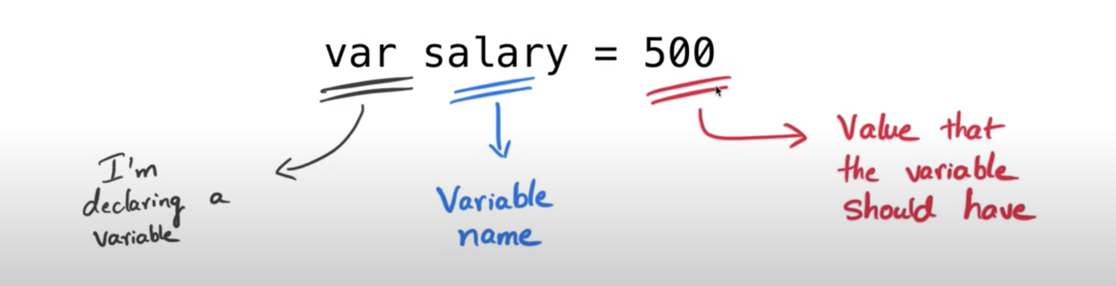
Variable declaration
int age;
double price = 10.5;
int count, sum;
int a = 7/2; What is answer ?
Newer versions of java (var introduced in Java 10)
var age = 25;
var price = 10.5;
var var = 10; -> will this execute
without error ?

Slide 15
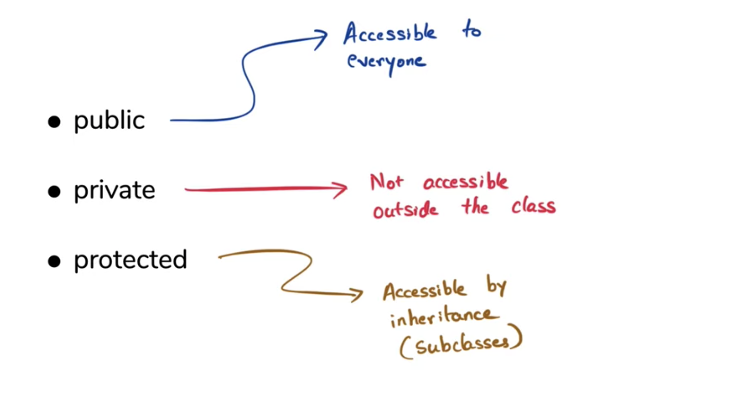
Access modifiers

Slide 16
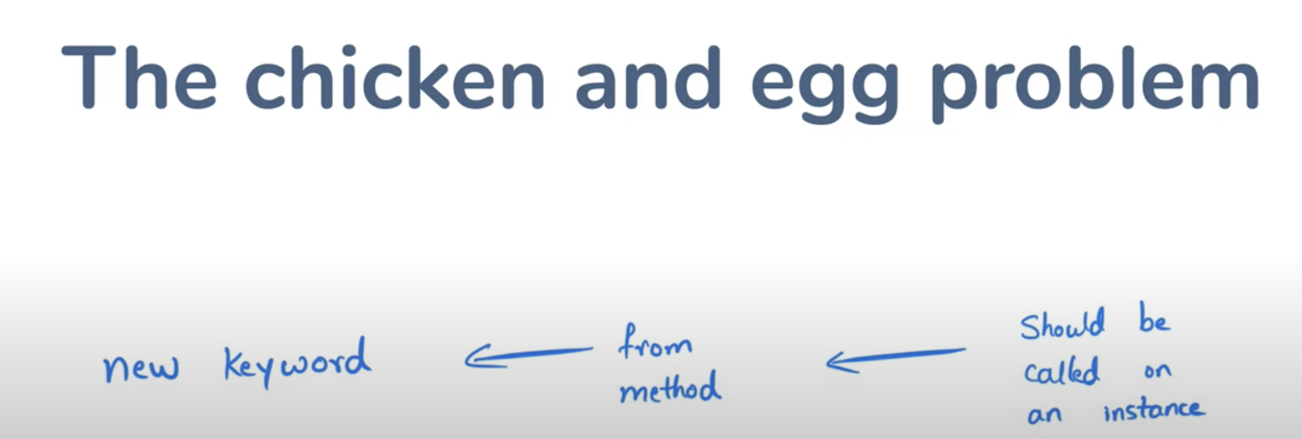
static modifier
static – when you need to define class member as independent from any object instance.
This is the reason main() method is static

Slide 17
final modifier
final int k =10;
k =20 -> C.E
For fields you can’t modify
For references you can’t re-assign

